Slide 1
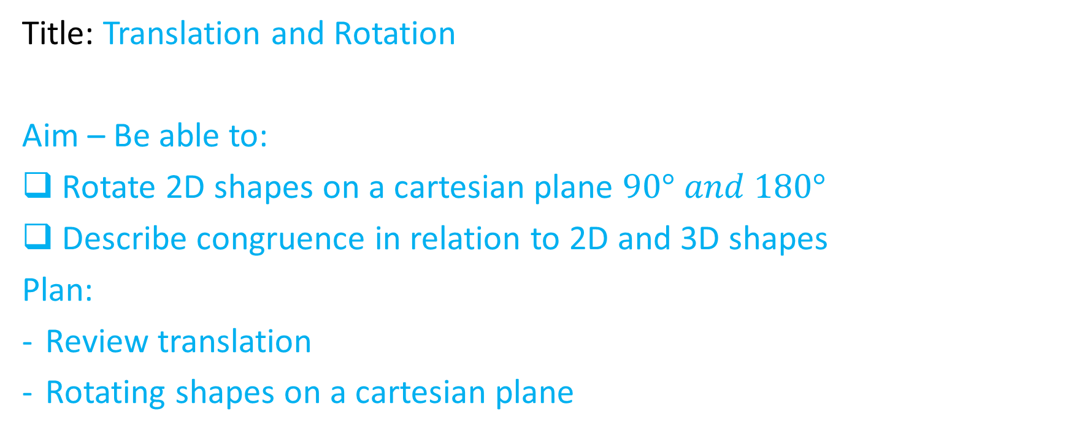
Lesson objective
Finished lesson objective? – finish translation activity from yesterday.
Title: Translation and Rotation
Aim – Be able to:
Rotate 2D shapes on a cartesian plane $90° and 180°$
Describe congruence in relation to 2D and 3D shapes
Plan:
Review translation
Rotating shapes on a cartesian plane
Need whiteboards - STARTING
PBiS focus: Learn
By asking for feedback

Slide 2
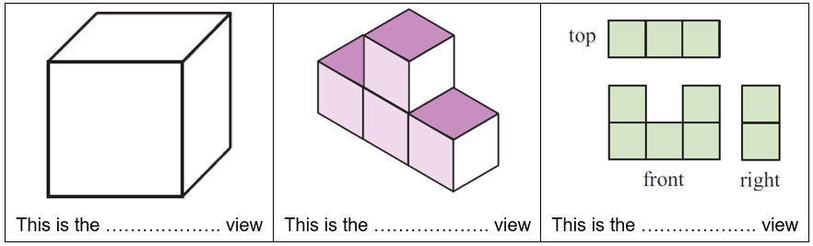
Types of view
Oblique (Flat face)
Isometric (diagonals)
Orthogonal (top, front and view)

Slide 3
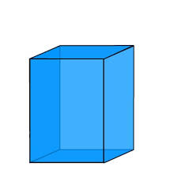
Whiteboards
Draw oblique:

Slide 4
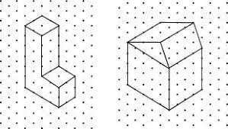
Whiteboards
Draw isometric:

Slide 5
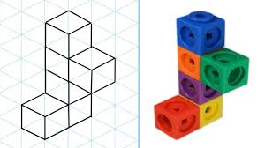
Whiteboards
Draw Orthogonal:
TOP VIEW
FRONT VIEW RIGHT VIEW

Slide 6
Translation
Translation
Is just a slide
Describing a translation involves saying how many units a shape is shifted left, right, up or down.
What directions?

Slide 7
Individual practice
Exercise A (Design a logo) pg. 97 & 98

Slide 8
Rotation
What sort of movement do you think is involved for rotation?
Rotation occurs around a single point.
We need to know:
Clockwise
Anti clockwise
Degrees
Simon says: degrees game.

Slide 9
Rotation
When we turned, we didn’t get bigger or smaller. We stayed the same size.
When we rotate an object it does not change size, the initial shape and the final shape are congruent (means they are the exact same).
Rotation happens around a single point. Sometimes that rotation point is the origin of the cartesian plane (0, 0).

Slide 10
Quick method
Step 1: sketch the image onto the baking paper
Step 2: Press the tip of your pen into the origin/rotation point
Step 3: Rotate the tracing paper (degrees clock or anti clockwise)
Step 4: sketch the new shape

Slide 11
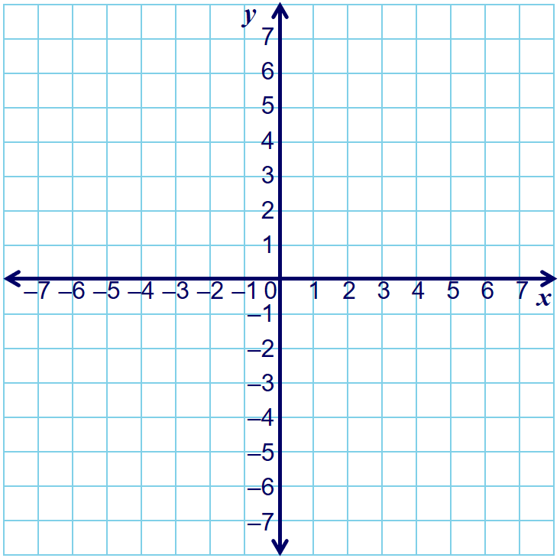

I DO
Step 1: sketch the image onto the baking paper
Step 2: Press the tip of your pen into the origin/rotation point
Step 3: Rotate the tracing paper (degrees clock or anti clockwise)
Step 4: sketch the new shape
Rotate the rectangle $90° clockwise$

Slide 12

We DO
Step 1: sketch the image onto the baking paper
Step 2: Press the tip of your pen into the origin/rotation point
Step 3: Rotate the tracing paper (degrees clock or anti clockwise)
Step 4: sketch the new shape
Rotate the triangle $90° anti−clockwise$

Slide 13

YOU DO
Step 1: sketch the image onto the baking paper
Step 2: Press the tip of your pen into the origin/rotation point
Step 3: Rotate the tracing paper (degrees clock or anti clockwise)
Step 4: sketch the new shape
Rotate the triangle $180° anti−clockwise$

Slide 14


YOU DO
Step 1: sketch the image onto the baking paper
Step 2: Press the tip of your pen into the origin/rotation point
Step 3: Rotate the tracing paper (degrees clock or anti clockwise)
Step 4: sketch the new shape
Rotate the triangle $180° clockwise$
What did we notice?
Challenge: rotate $45°$ anti clockwise.

Slide 15
Individual task
Exercise B (designing a logo) pg. 99 - 103.

Slide 16
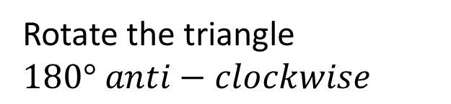
YOU DO
Step 1: sketch the image onto the baking paper
Step 2: Press the tip of your pen into the origin/rotation point
Step 3: Rotate the tracing paper (degrees clock or anti clockwise)
Step 4: sketch the new shape
Rotate the triangle $180° anti−clockwise$

Slide 17


YOU DO
Step 1: sketch the image onto the baking paper
Step 2: Press the tip of your pen into the origin/rotation point
Step 3: Rotate the tracing paper (degrees clock or anti clockwise)
Step 4: sketch the new shape
Rotate the triangle $180° clockwise$
What did we notice?
Challenge: rotate $45°$ anti clockwise.

Slide 18

Which shows $90°$Clockwise?
A
A
B
B

Slide 19

Which does not show $180°$rotation?
A
A
B
B

